Slide 1
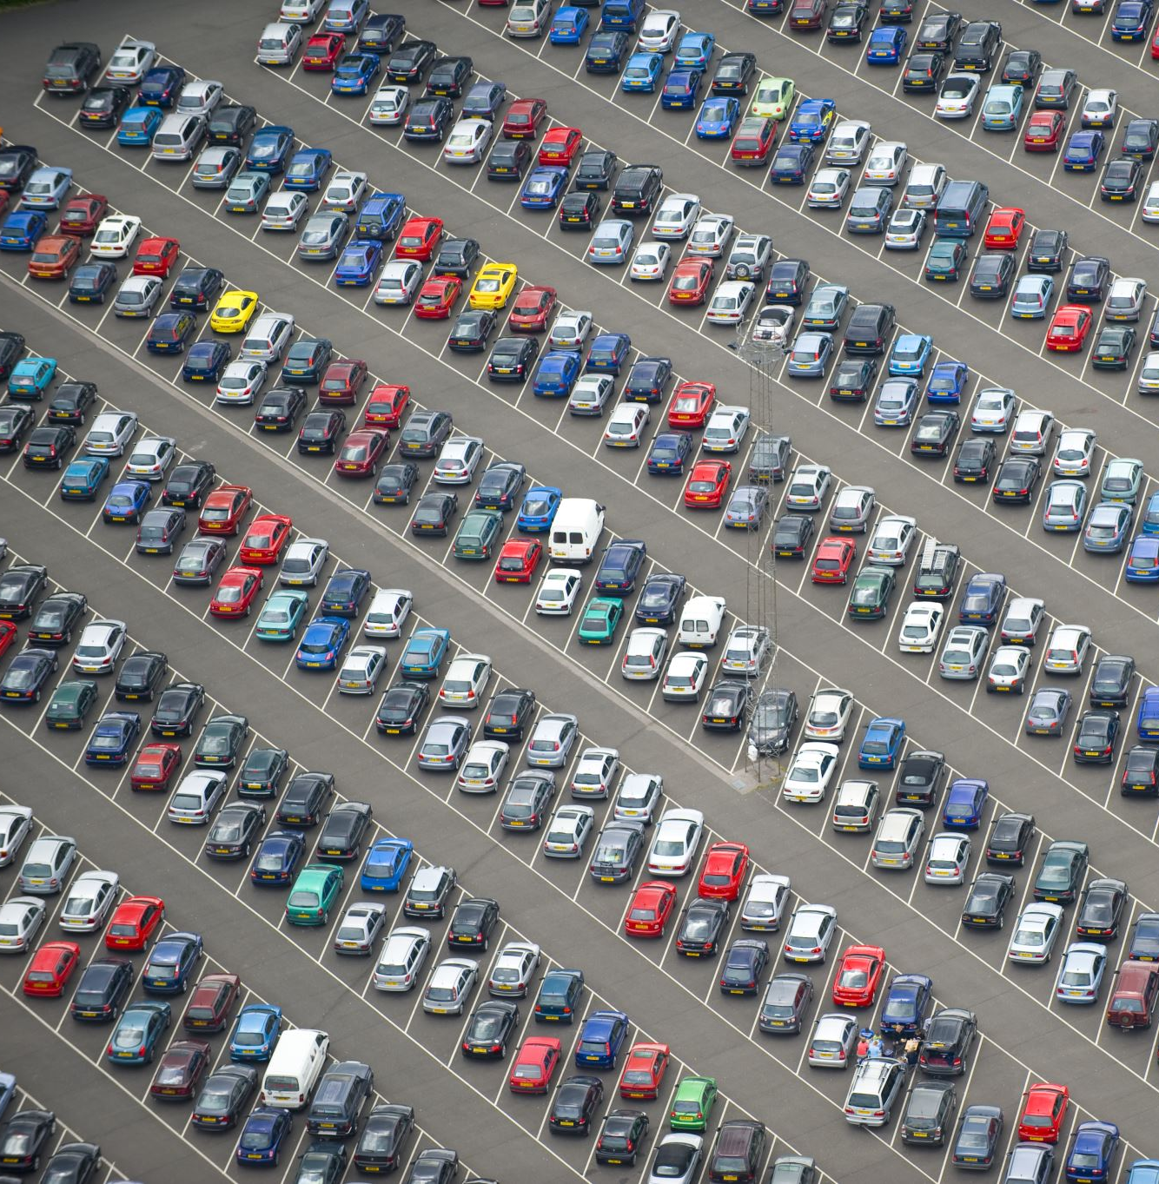
PARKING SLOTS APP
Grupo 2
Adrián Salas Rodrigues
Adrián Fuentes Ampudia
Rafael Martín Lesmes
Augusto José López Mihali

Slide 2

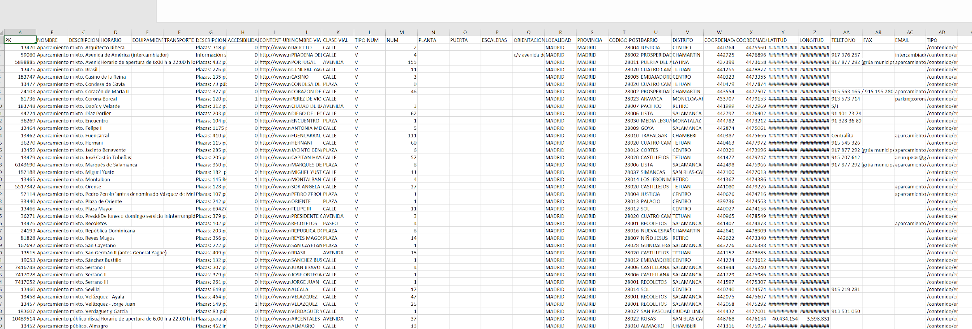
HANDS-ON 1

Slide 3

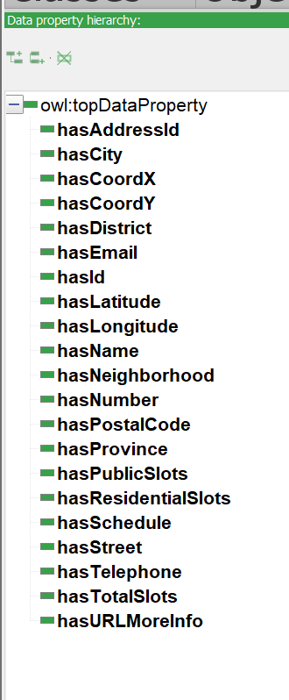
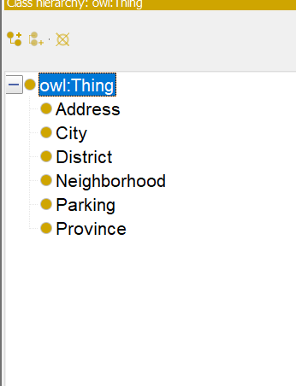
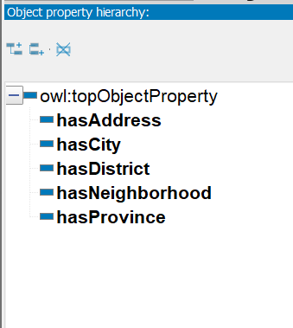
HANDS-ON 2
Data Properties:
Estrategia de nombrado:
CLASES:
Object Properties:

Slide 4


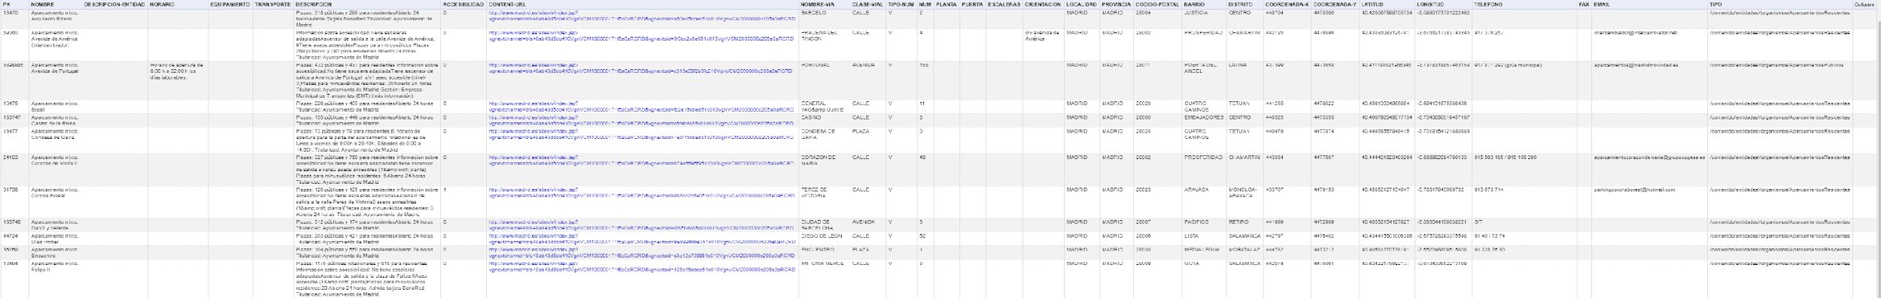

HANDS-ON 3
GREL

Slide 5




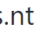

HANDS-ON 4

Slide 6




HANDS-ON 5

Slide 7
HANDS-ON 5
RECONCILIATIONS:
Street → Street Wikidata
Province → Province Wikidata
City → City Wikidata
District → District Wikidata
Neighborhood → Neighborhood Wikidata
https://www.wikidata.org/wiki/Q2807

Slide 8
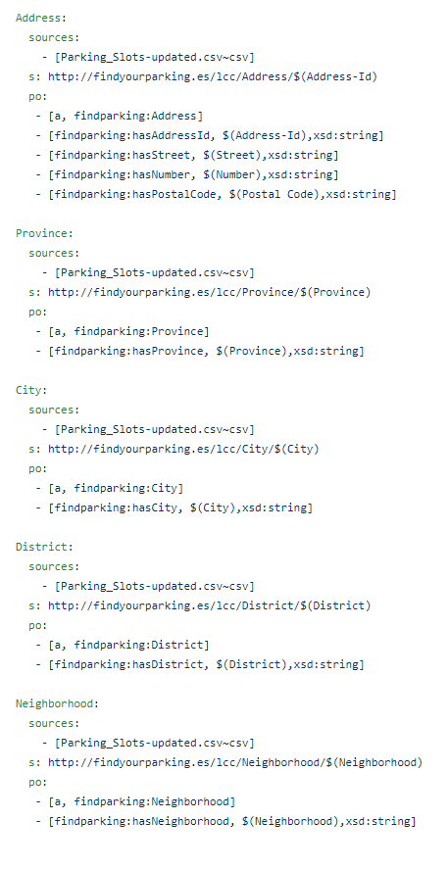
HANDS-ON 4

Slide 9
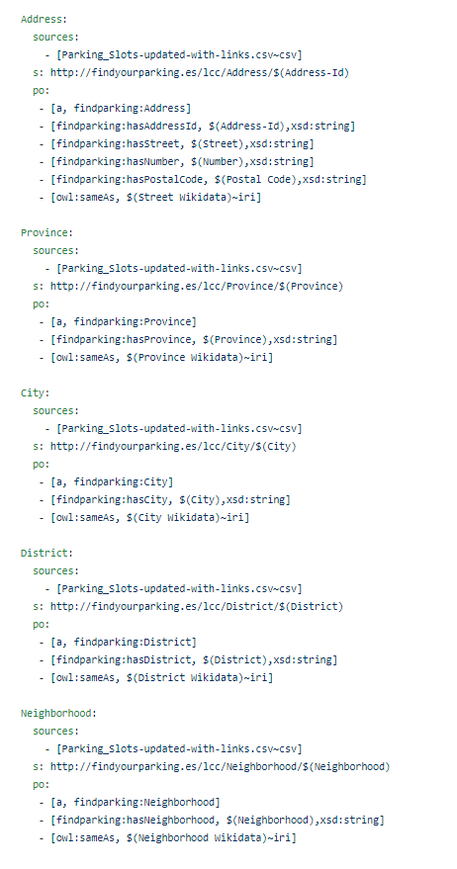
HANDS-ON 5

Slide 10
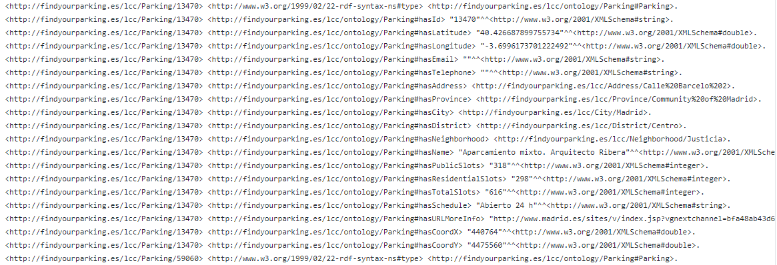
HANDS-ON 5
owl:sameAs

Slide 11
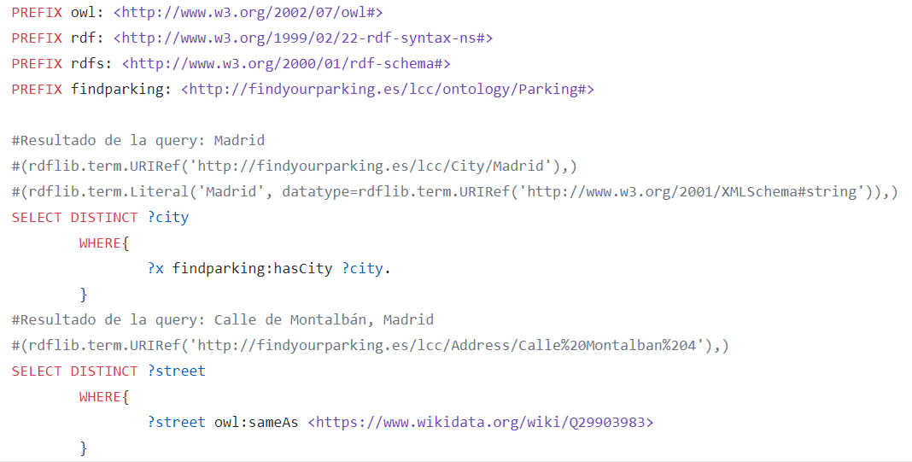
HANDS-ON 5

Slide 12





OnToology

Slide 13


>> demostración de la app

Slide 14
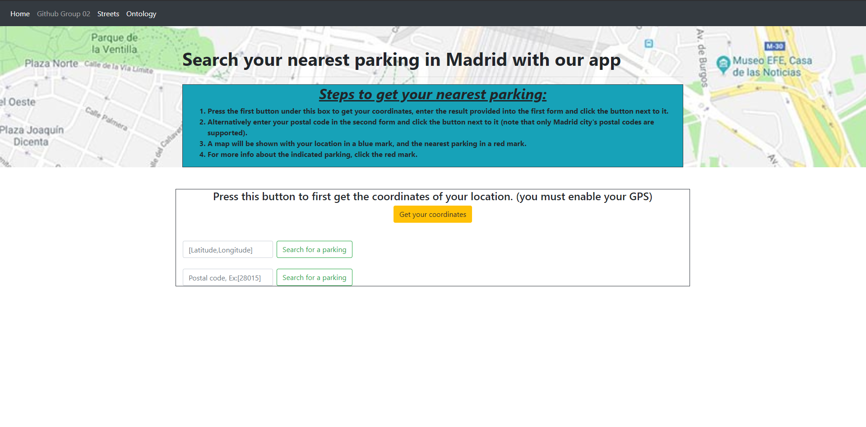

Slide 15
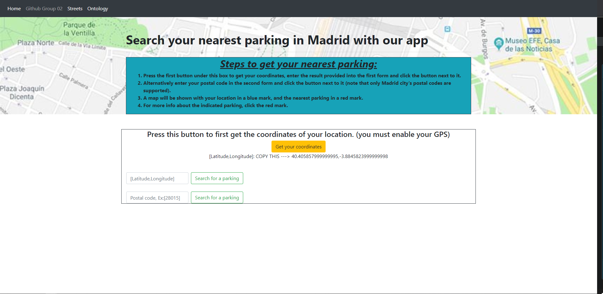

Slide 16
